Slide 1
International Commission on Occupational Health

Slide 2
About ICOH
The International Commission on Occupational Health (ICOH) is an international non-profitmaking, non-political, multidisciplinary scientific organisation whose sole purpose is to foster the scientific progress, knowledge and development of occupational health and related subjects on an international basis.
(Constitution, Article 1, Section 1)

Slide 3
About ICOH
ICOH provides a forum for scientific and professional communication. To achieve this purpose, the ICOH:
sponsors international congresses and meetings on occupational health;
establishes scientific committees in various fields of occupational health and related subjects;
disseminates information on occupational health activities;
issues guidelines and reports on occupational health and related subjects;
collaborates with appropriate international and national bodies on matters concerning occupational and environmental health;
takes any other appropriate action related to the field of occupational health;
solicits and administers such funds as may be required in furtherance of its objectives.
(Constitution, Article 1, Section 2)

Slide 4
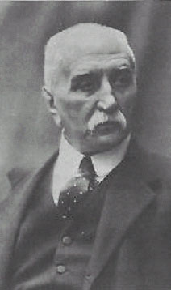
1906 Milan
First International Congress for Occupational Health
Foundation of the International Permanent Commission for Occupational Health
1906 Congress proceedings
Malachia De Cristoforis, founder and first President of the International Permanent Commission for Occupational Health

Slide 5
21th International Congress for Occupational Health - 1984 - Dublin
The Permanent Commission and International Association of Occupational Health becomes International Commission on Occupational Health (ICOH)
New professional groups participate: industrial medical officers, occupational health specialists, etc.

Slide 6
INTERNATIONAL CONGRESSES ON OCCUPATIONAL HEALTH
2022 Rome-Melbourne digital congress
2024 Marrakesh
2009 Cape Town
2012 Cancun
2015
Seoul
2018 Dublin
2027 Mumbai
1906 Milan
2006 Milan
1910 Brussels
2003 Iguassu Falls
1925 Amsterdam
2000 Singapore
1928 Budapest
1996 Stockholm
1931 Geneva
1993 Nice
1935 Brussels
1990 Montreal
1938 Frankfurt
1987 Sydney
1948 London
1984 Dublin
1951 Lisbon
1981 Cairo
1954 Naples
1978 Dubrovnik
1957 Helsinki
1975 Brighton
1972 Buenos Aires
1969 Tokyo
1966 Vienna
1963 Madrid
1960 New York

Slide 7
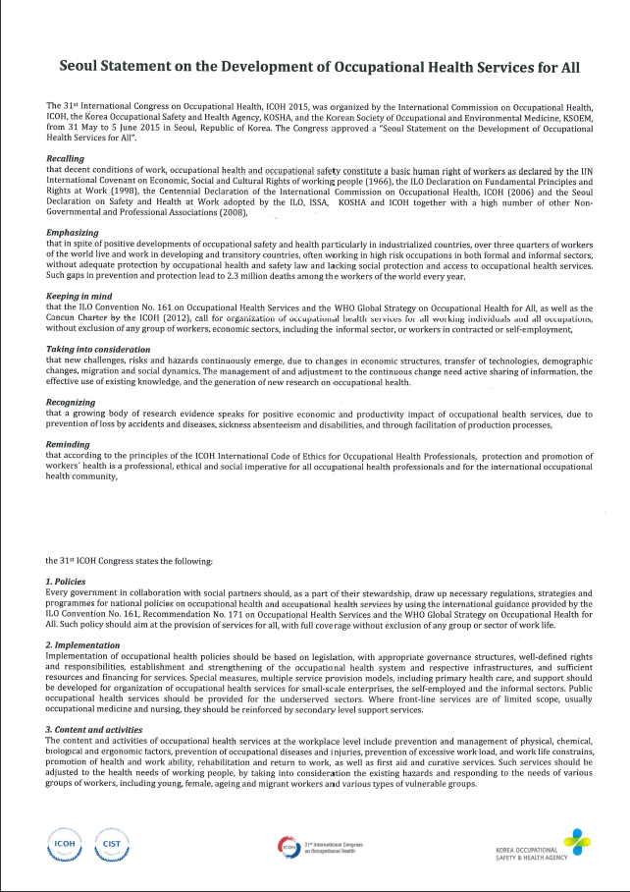
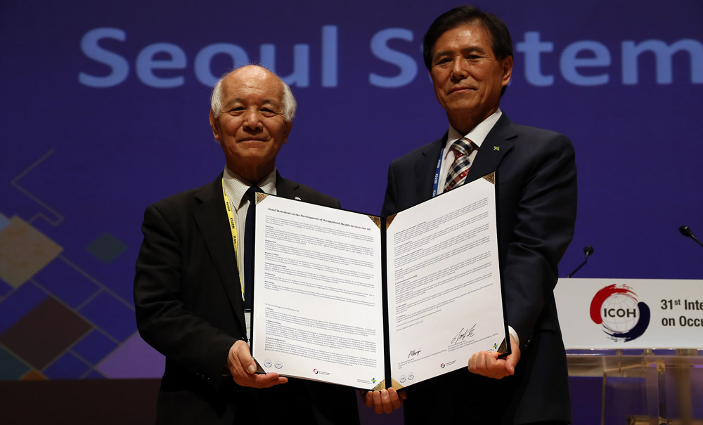
Seoul Statement on the Development of Occupational Health Services for All
…the signing at ICOH 2015

Slide 8
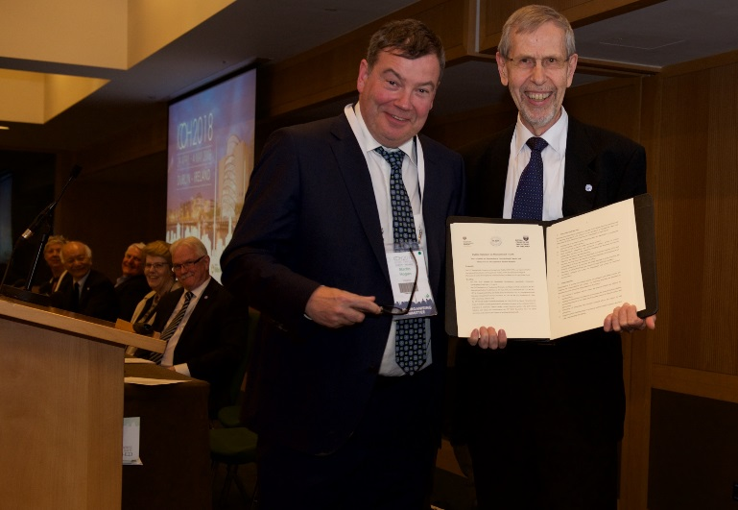
Dublin Statement on Occupational Health
…the signing at ICOH 2018

Slide 9
ICOH Statement on protecting Occupational Safety and Health of Migrant Workers
The statement is the result of a joint effort by:
ICOH Working Group on Future of Decent Work
ICOH SC on Thermal Factors
ICOH SC on Occupational Health in Small-Scale Enterprises and the Informal Sector
ICOH Officers
ICOH Board Members
Available at :
https://www.icohweb.org/site/multimedia/news/pdf/Occupational%20health%20of%20migrant%20workers.pdf
Safety and Health at Work (2022), 13:261-2.

Slide 10
ICOH 2024
34th International Congress on Occupational Health
Marrakesh, Morocco 28 April – 3 May 2024

Slide 11
ICOH Governmental Partners
World Health Organization
International Labour Organization
ICOH Non Governmental Partners
International Ergonomics Association
International Social Security Association
International Occupational Hygiene Association

Slide 12
Members in Good Standing
Membership type | 2021
Active (A) | 1792
Retired (R) | 28
Honorary (H) | 25
Emeritus (E) | 219
Affiliate (AFF) | 25
Sustaining (SUS) | 18
Total | 2107
+ 6.7% increase since 2018
Data refer to the end of the 2018-2021 term

Slide 13
2107
Members per country*
Country | Members
1) India | 194
2) USA | 122
3) Japan | 114
4) Italy | 112
5) Brazil | 92
6) Australia | 70
7) South Africa | 69
8) Peru | 66
9) Mexico | 62
10)Finland | 55
11)The Netherlands | 45
11)Indonesia | 45
13) France | 44
14) Philippines | 41
14) Russian Federation | 41
* Data refer to the end of the 2018-2021 triennium

Slide 14
New members*
755 new members in good standing 2018-2021
Country | New members
India | 97
Brazil | 42
Russian Federation | 33
South Africa | 32
USA | 31
Philippines | 29
Indonesia | 28
Mexico | 26
Australia | 25
Italy | 23
*Data refer to the end of the 2018-2021 triennium

Slide 15
Geographical distribution - GDP per capita
2021
Low-Income Countries 27.9%
High-Income Countries 41.8%
58.2%
Middle-Income Countries 30.3%
Data refer to the end of the 2018-2021 triennium

Slide 16
Individual member profile
Profession
Average age
Gender distribution
52
Data refer to the end of the 2018-2021 triennium

Slide 17
ICOH Sustaining Members
Institut de recherche Robert-Sauvé en santé et en sécurité du travail Canada
Institute for health protection and safety at work
Croatia
National Research Centre for the Working Environment
Denmark
The Finnish Work Environment Fund Finland
Bundesanstalt für Arbeitsschutz und Arbeitsmedizin Germany
Finnish Institute of Occupational Health Finland
Italian Workers’ Compensation Authority Italy
OH Promotion Foundation Japan
University of Occupational & Environmental Health Japan
National Institute for Occupational Safety and Health USA
Fondazione Maugeri Italy

Slide 18
ICOH Sustaining Members
KOSHA Rep. of Korea
Workplace Safety and
Health Institute
Singapore
Prevent
Sweden
International SOS Foundation The Netherlands
International Institute of Risk and Safety Management
United Kingdom
Institution of Occupational Safety and Health United Kingdom
Kundiiev Institute of Occupational Health of the National Academy of Medical Sciences, Ukraine
Fundacentro Brazil

Slide 19
ICOH Affiliate Members

Slide 20
ICOH Affiliate Members

Slide 21
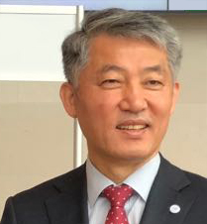
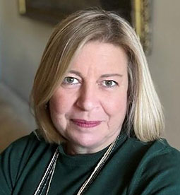
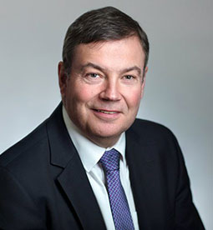
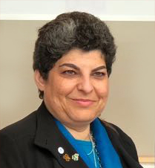
ICOH Officers
President
Seong-Kyu Kang
Republic of Korea
Secretary General
Diana Gagliardi
Italy
Vice-President
Claudina Nogueira South Africa
Vice-President
Martin Hogan Ireland

Slide 22
ICOH Board 2022-2024
Alexis Descatha
Maureen Dollard
Frida Marina Fischer
Sunil Kumar
Joshi
Eun-A Kim
Kirsi Lappalainen
Stavroula Leka
Olivier Lo
Dingani Moyo
Shyam Pingle
Riitta Sauni
Paul Schulte
Sandeep Sharma
Akizumi Tsutsumi
Francesco Violante

Slide 23
ICOH National/Area Secretaries worldwide

Slide 24
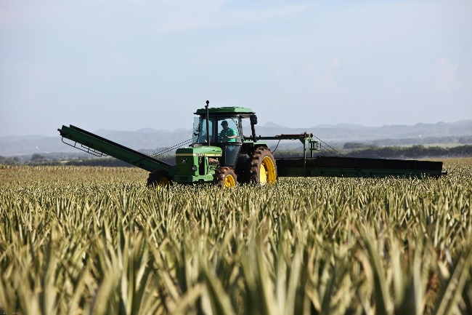
ICOH Accomplishments
ICOH activities cover a wide range of topics, as reflected by the 38 Scientific Committees, each one focused on a specific area.

Slide 25
Scientific Committees
Accident Prevention
Effectiveness in Occupational Health Services
Emergency Preparedness and Response in Occupational Health
Epidemiology in Occupational Health
Allergy and Immunotoxicology
Cardiology in Occupational Health
Education and Training in Occupational Health
Aging and Work
Biohazards and Occupational Health

Slide 26
Scientific Committees
History of Prevention of Occupational and Environmental Diseases
Indoor Air Quality and Health
Nanomaterial Workers’ Health
Neurotoxicology and Psychophysiology
Occupational and Environmental Dermatoses
Occupational Health and Development
Industrial Hygiene
Mining Occupational Safety and Health
Musculoskeletal Disorders

Slide 27
Scientific Committees
Occupational Health for Health Workers
Occupational Health in Small-Scale Enterprises and the Informal Sector
Occupational Medicine
Occupational Toxicology
Radiation and Work
Reproductive Hazards in the Workplace
Occupational Health in the Chemical Industry
Occupational Health in the Construction Industry
Occupational Health Nursing

Slide 28
Scientific Committees
Respiratory Disorders
Rural Health: Agriculture, Pesticides and Organic Dusts
Unemployment, Job Insecurity and Health
Vibration and Noise
Women Health and Work
Work and Vision
Shiftwork and Working Time
Thermal Factors
Toxicology of Metals
Work Disability Prevention and Integration
Work Organization and Psychosocial Factors

Slide 29
ICOH CORE DOCUMENTS

Slide 30
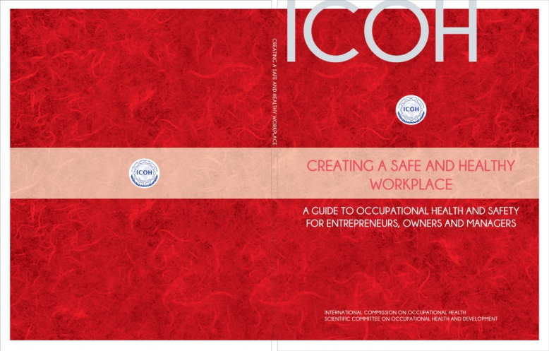
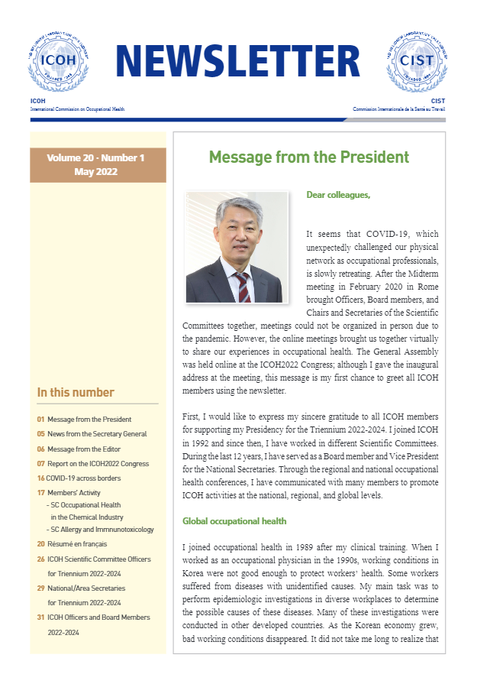
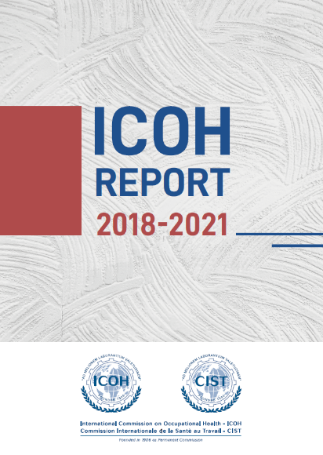
ICOH Outputs

Slide 31
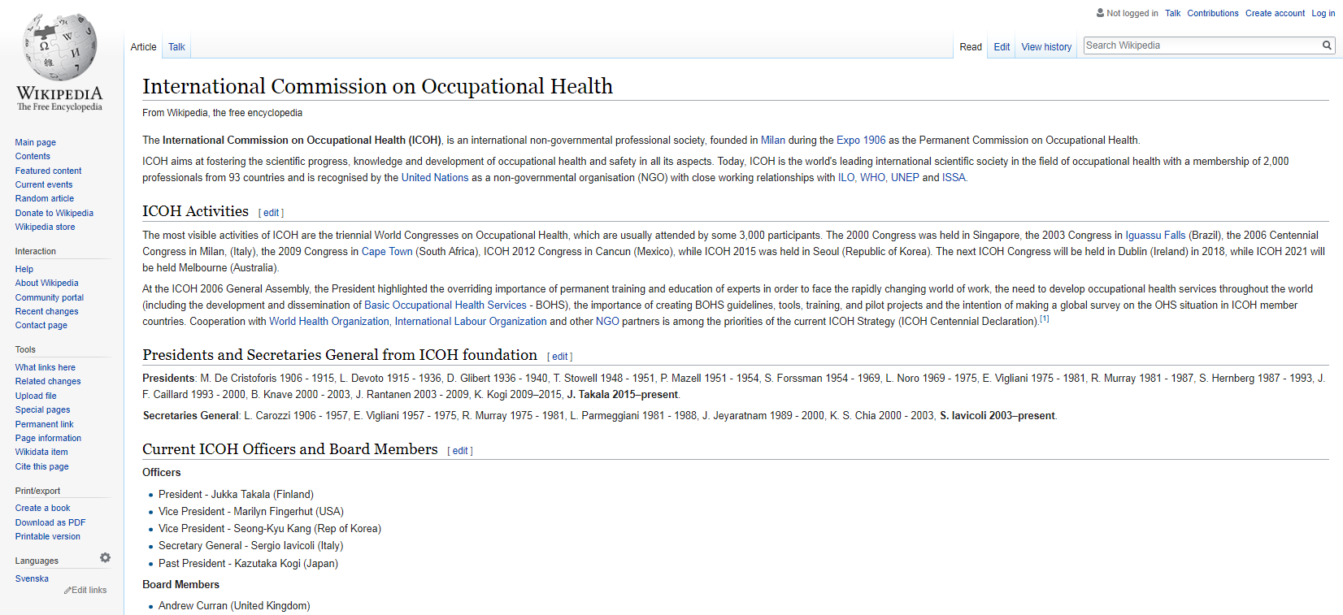
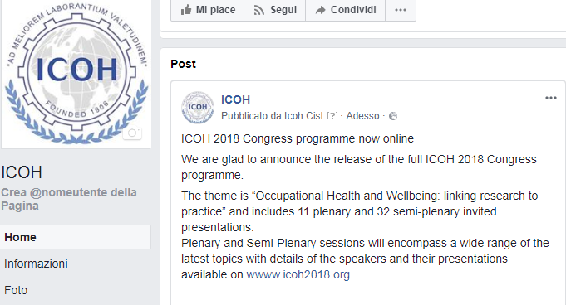
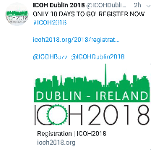
ICOH on social networks
ICOH online: social media and more
ICOH 2.0
www.icohweb.org

Slide 32
Benefits and tools for members
Website and Private Area
ICOH Newsletter and Publications
Noro fund
Grant for congress attendees from developing countries
ILO Master Fellowship
Student Awards
ICOH social media
Journal discounts
Participation in SCs

Slide 33
INDIVIDUAL MEMBERSHIP FEES 2021-2024
COUNTRIES WITH | GDP<5,000 USD | 5,000<GDP<15,000 USD | GDP>15,000 USD
ACTIVE MEMBERS | 45.00 CHF | 72.00 CHF | 345.00 CHF
YOUNG <34 | 30.00 CHF | 45.00 CHF | 72.00 CHF
RETIRED | 30.00 CHF | 60.00 CHF | 90.00 CHF
Members joining in 2022 will pay 2/3 of the triennial membership fee.
Applications can be submitted through the ICOH website www.icohweb.org

Slide 34
SUSTAINING MEMBERS FEES 2021-2024
LOW INCOME COUNTRIES GDP < 5,000 | 800 CHF
MEDIUM INCOME COUNTRIES 5,000 < GDP < 15,000 | 2,500 CHF
HIGH INCOME COUNTRIES GDP > 15,000 | 5,000 CHF
AFFILIATE MEMBERS FEES 2021-2024
>200 MEMBERS | 660 CHF
<200 MEMBERS | 440 CHF

